Slide 1









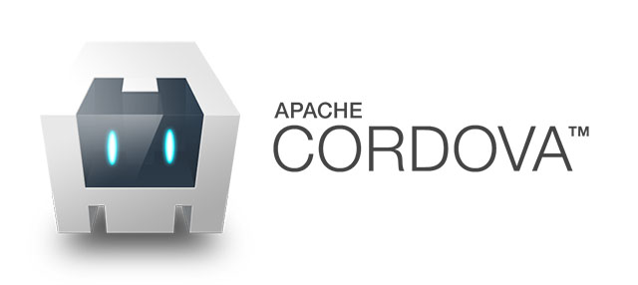

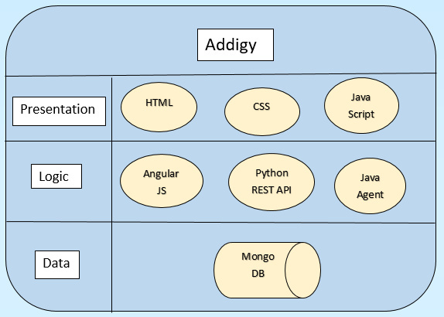
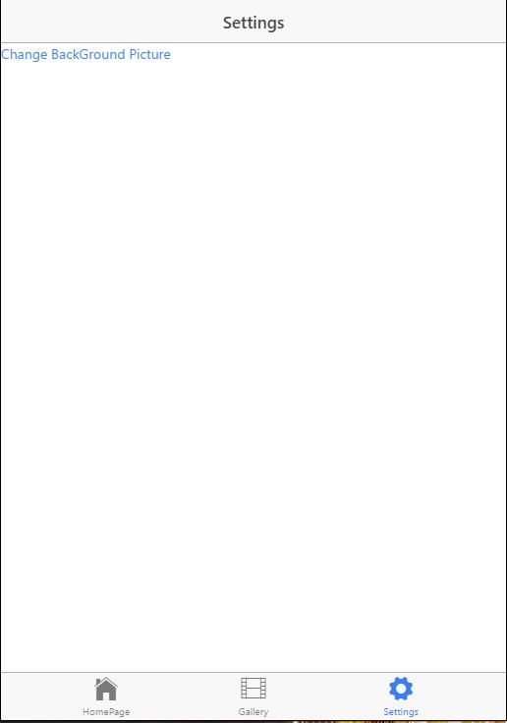
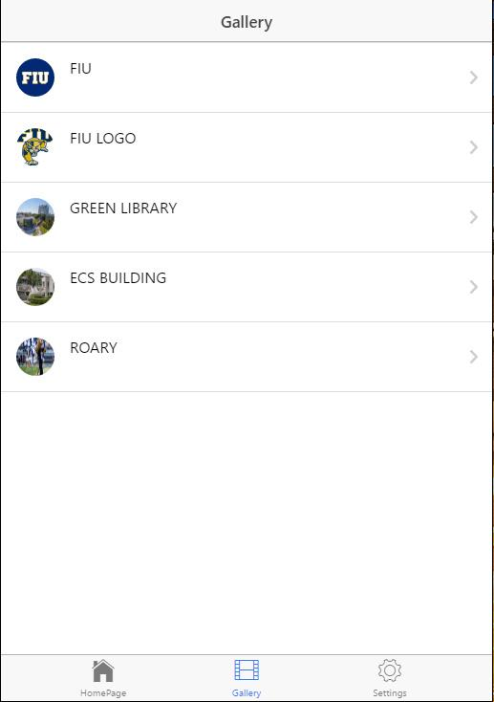



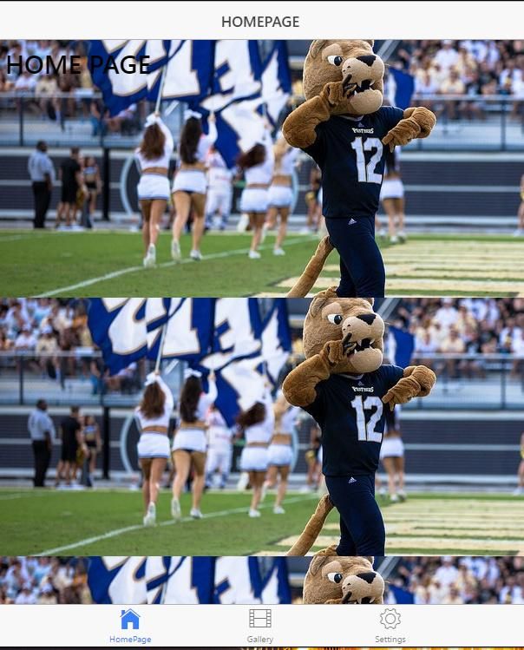
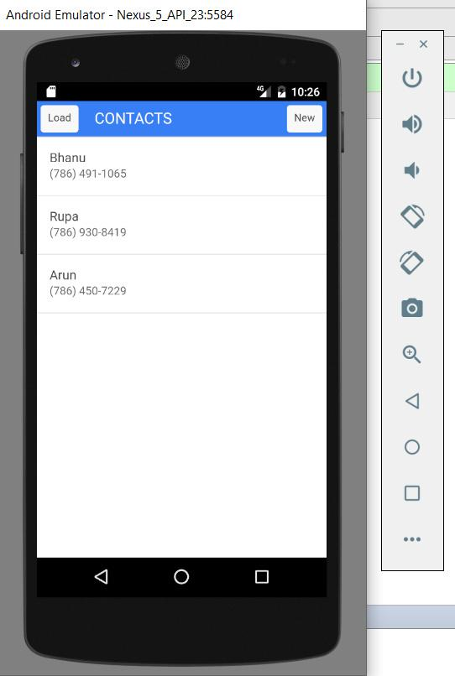
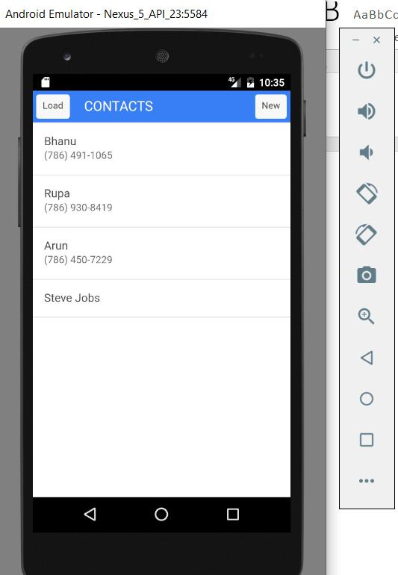
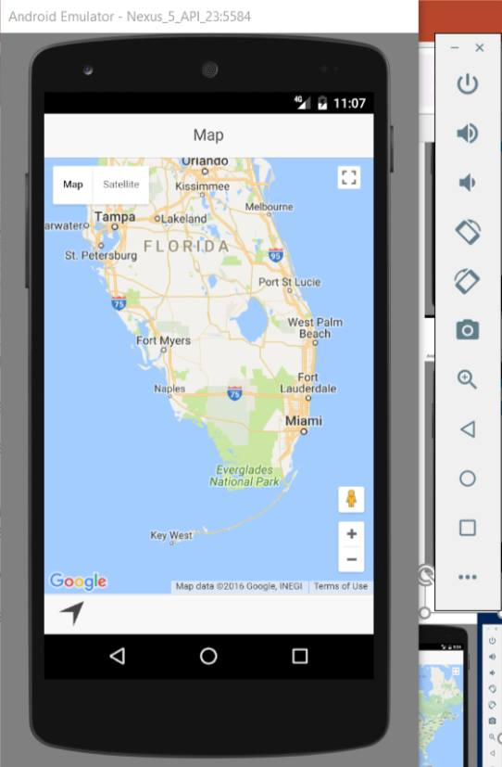
School of Computing & Information Sciences
Advanced Software Engineering, 2016, Fall
Addigy 6.0
Student: Rupa Kotha, Florida International University
Mentor: Jason Dettbarn, Addigy
Instructor: Masoud Sadjadi, Florida International University
Problem
Current System
Requirements
Addigy Simplifies and streamlines the IT management of your Macs.
Idea of the project is basically to create a system which can monitor and apply configurations to both IOS and Android in mobile devices.
The applications with in the mobile communicates with a web server to report monitoring data and retrieve configurations .
A website component is needed for admin to setup configurations and monitor data.
Addigy is a mobile device management system.
The Policy management or Deployment which means Take control.
Operating Systems and Application management which are OS versions, Updates and apps .
Asset management can be Encryption, security and file vault keys.
The mobile devices are remotely monitored by the system.
Configurations of the mobile is applied by the system.
The system shall display a graph of users login/out activity.
The system consists of applications that work on mobile devices and communicate to the web service to report monitoring data.
The system applications retrieve configurations from web service.
The system administrator for setting configurations and for data monitoring, it needs a website component .
System Design
Screen shots
Implementation
Works on Android and IOS Platforms .
Uses Ionic Framework to create hybrid applications.
The user interface uses Angular Html and CSS.
A Client-Server architecture was used to handle one-to-many communication between the devices collector written in Java and administrator dashboard, using AngularJS from a browser with the server.
Verification
● Test Case ○ Purpose: User should be able to set an image from the gallery as the wallpaper.
○ Precondition: User should go to the settings page and select ‘change background option’.
○ Input: User should select an image to set as background image.
○ Expected Result: The image should be set as the background image.
○ Actual Result: The image set as the background image.
○ Status: SUCCESS
● Test Case ○ Purpose: User should be able to change background image .
○ Precondition: User should go to the settings page and select ‘change background option’.
○ Input: User should select an image to set as background image.
○ Expected Result: The image should be set as the background image.
○ Actual Result: The image set as the background image.
○ Status: SUCCESS
● Test Case ○ Purpose: User pushes the load button and app fetches the contacts from the device phonebook.
○ Precondition: User should open the Contacts app.
○ Input: User pushes the load button.
○ Expected Result: The app should load contacts from the device phonebook.
○ Actual Result: App loads the contacts
○ Status: SUCCES
Summary
Computers have become one of the most valuables assets for companies nowadays. IT Intelligence at scale provides some sort of intelligence to assist when taking decisions regarding these assets.
IT Administrators need a way to easily digest the large volume of data about the systems in their organization so that they can easily diagnosis problems and make decisions.
My Project contribution to Addigy’s system:
Learned to build hybrid mobile applications using Ionic framework.
Application that fetches images from gallery and setting image as the wallpaper.
Application that fetches contacts from the device phonebook and adds contacts to the device phone book.
Application that integrates google maps to the ionic application.
Acknowledgement
I am thankful to the help that I received from Mohsen Taheri and my group member Bhanu Varma
Notes:
1

